Slide 1
Lesson 4: Combining data from multiple tables
A Short Course to Learn SQL Basics
Kevin Patrick
Ryan Kuhns
Michael Headlee

Slide 2
Course Outline
Intro to SQL and relational databases
Functions and sorting data
Conditional column calculations and subsets of rows
Combining data from multiple tables
Summarizing data across rows (i.e.: grouping)
Using subqueries
Review of lessons 1-6 and examples with more complex functions
Stored procedures and parameters
Modifying and maintaining data
Overall review and real world and student submitted examples

Slide 3
Course Outline
Intro to SQL and relational databases
Functions and sorting data
Conditional column calculations and subsets of rows
Combining data from multiple tables
Summarizing data across rows (i.e.: grouping)
Using subqueries
Review of lessons 1-6 and examples with more complex functions
Stored procedures and parameters
Modifying and maintaining data
Overall review and real world and student submitted examples

Slide 4
Entity-relationship diagram
Order Table
OrderId
CustomerId
QuantitySold
PricePerUnit
Customer Table
CustomerID
FirstName
LastName

Slide 5
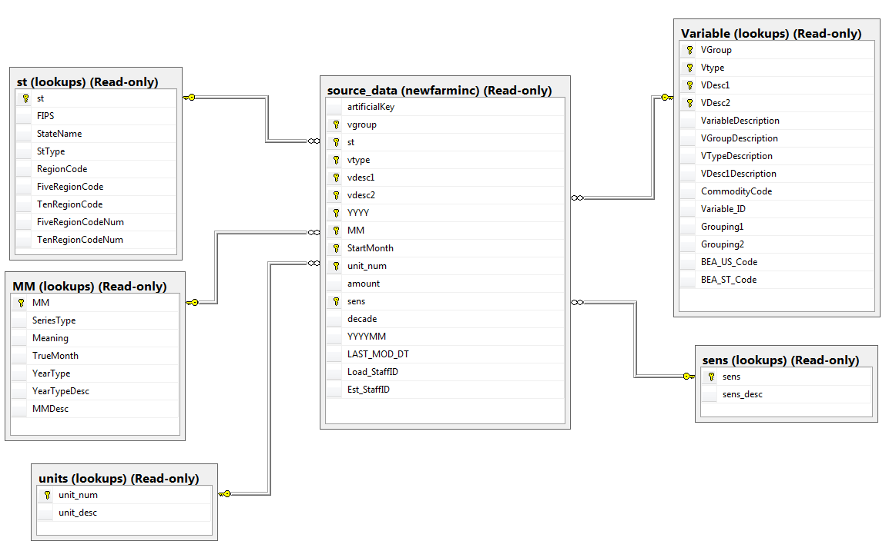
Relational Database: Example 2

Slide 6
Combining tables is essential to SQL
Relational databases are useful because it easily allows you to combine data from multiple tables
Two main ways to join tables
Inner join (column matches in each table)
Outer join (column matches in at least one table)
Set logic (union and interest tables)

Slide 7
Inner join: Example 1
Table: Customers
Table: Orders
CustomerID | FirstName | LastName
1 | Michael | Headlee
2 | Ryan | Kuhns
3 | Kevin | Patrick
OrderID | CustomerID | Quantity | PricePerUnit
1 | 1 | 5 | 1.6
2 | 2 | 3 | 2.0
3 | 2 | 7 | 3.0
Select *
From Customers
Inner Join Orders
On Customers.CustomerID=Orders.CustomerID
Query result:
CustomerID | FirstName | LastName | OrderID | CustomerID | Quantity | PricePerUnit
1 | Michael | Headlee | 1 | 1 | 5 | 1.6
2 | Ryan | Kuhns | 2 | 2 | 3 | 2.0
2 | Ryan | Kuhns | 3 | 2 | 7 | 3.0

Slide 8
Inner join: Example 2
Table: Customers
Table: Orders
CustomerID | FirstName | LastName
1 | Michael | Headlee
2 | Ryan | Kuhns
3 | Kevin | Patrick
OrderID | CustomerID | Quantity | PricePerUnit
1 | 1 | 5 | 1.6
2 | 2 | 3 | 2.0
3 | 2 | 7 | 3.0
Select *
From Customers
Inner Join Orders
On Customers.CustomerID=Orders.CustomerID
Select *
From Orders
Inner Join Customers
On Customers.CustomerID=Orders.CustomerID
Query result:
CustomerID | FirstName | LastName | OrderID | CustomerID | Quantity | PricePerUnit
1 | Michael | Headlee | 1 | 1 | 5 | 1.6
2 | Ryan | Kuhns | 2 | 2 | 3 | 2.0
2 | Ryan | Kuhns | 3 | 2 | 7 | 3.0

Slide 9
Alternative specification for Inner join
Table: Customers
Table: Orders
CustomerID | FirstName | LastName
1 | Michael | Headlee
2 | Ryan | Kuhns
3 | Kevin | Patrick
OrderID | CustomerID | Quantity | PricePerUnit
1 | 1 | 5 | 1.6
2 | 2 | 3 | 2.0
3 | 2 | 7 | 3.0
Using inner join syntax:
Select *
From Customers
Inner Join Orders
On Customers.CustomerID=Orders.CustomerID
Inner join and On keywords used to join tables
These queries return the same result, but inner join syntax is preferred because it is more clear.
Alternative syntax:
Both tables listed in From clause.
Select *
From Customers, Orders
Where Customers.CustomerID=Orders.CustomerID
Where clause subsets data so only matched rows are returned

Slide 10
Choosing individual columns from joined tables
Select *
From Customers
Inner Join Orders
On Customers.CustomerID=Orders.CustomerID
Choosing all columns (select *) results in duplicates of the “join” column
Query result:
CustomerID | FirstName | LastName | OrderID | CustomerID | Quantity | PricePerUnit
1 | Michael | Headlee | 1 | 1 | 5 | 1.6
2 | Ryan | Kuhns | 2 | 2 | 3 | 2.0
2 | Ryan | Kuhns | 3 | 2 | 7 | 3.0
There are two options to avoid this:
1. Use “qualified” columns
Select Z.CustomerID, Z.FirstName,
LastName, W.OrderID,
W.Quantity, W.PricePerUnit
From Customers As Z
Inner Join Orders W
On Z.CustomerID=W.CustomerID
You list the individual columns using column “qualifiers” to indicate the table the columns are from.
You only have to use column “qualifier” for the join column (note we didn’t use one on the LastName column). But column qualifiers make it easier to understand where the columns come from.
Notes:
Our original query worked, but we probably don’t want to have those duplicate CustomerID columns. It would be nice to be able to reference each column we want from each table.
Table aliases allow you to do just that. You create a table alias using the as keyword after the name of the table. We chose C for the customer table and O for the orders table. Notice that the as keyword is optional when creating a table alias, but it is recommended for clarity.
You can then reference to column using its two level name, table alias first then name of column.

Slide 11
Choosing individual columns from joined tables
Select *
From Customers
Inner Join Orders
On Customers.CustomerID=Orders.CustomerID
Choosing all columns (select *) results in duplicates of the “join” column
Query result:
CustomerID | FirstName | LastName | OrderID | CustomerID | Quantity | PricePerUnit
1 | Michael | Headlee | 1 | 1 | 5 | 1.6
2 | Ryan | Kuhns | 2 | 2 | 3 | 2.0
2 | Ryan | Kuhns | 3 | 2 | 7 | 3.0
There are two options to avoid this:
2. Use “qualified” select all
Select Z.*, W.OrderID, Quantity, W.PricePerUnit
From Customers As Z
Inner Join Orders W
On Z.CustomerID=W.CustomerID
You can select all the columns in the Customers (i.e.: Z.*) table, and list the three columns from Orders
Notes:
Our original query worked, but we probably don’t want to have those duplicate CustomerID columns. It would be nice to be able to reference each column we want from each table.
Table aliases allow you to do just that. You create a table alias using the as keyword after the name of the table. We chose C for the customer table and O for the orders table. Notice that the as keyword is optional when creating a table alias, but it is recommended for clarity.
You can then reference to column using its two level name, table alias first then name of column.

Slide 12
Outer joins
TableA
TableB
TableA
TableB
TableA
TableB
Left join
Right join
Full join
Left table is primary right table is secondary.
All rows from left table are returned
Right table is primary left table is secondary.
All rows from right table are returned
Both tables are secondary.
All rows from both tables regardless of a match or not
Select *
From TableA as A
Left Join TableB as B
On A.id=B.id
Select *
From TableA as A
Right Join TableB as B
On A.id=B.id
Select *
From TableA as A
Full Join TableB as B
On A.id=B.id

Slide 13
Outer joins: Left Join Example
Table: Customers
Table: Orders
CustomerID | FirstName | LastName
1 | Michael | Headlee
2 | Ryan | Kuhns
3 | Kevin | Patrick
OrderID | CustomerID | Quantity | PricePerUnit
1 | 1 | 5 | 1.6
2 | 2 | 3 | 2.0
3 | 2 | 7 | 3.0
Select A.*, OrderID, Quantity, PricePerUnit
From Customers A
Left Join Orders B
On A.CustomerID=B.CustomerID
Customers is the table to the left of the “left join” keywords, so we expect to retain all the rows in Customers and join matching data in Orders.
Query result:
CustomerID | FirstName | LastName | OrderID | Quantity | PricePerUnit
1 | Michael | Headlee | 1 | 5 | 1.6
2 | Ryan | Kuhns | 2 | 3 | 2.0
2 | Ryan | Kuhns | 3 | 7 | 3.0
3 | Kevin | Patrick | NULL | NULL | NULL

Slide 14
Outer joins: Right Join Example
Table: Customers
Table: Orders
CustomerID | FirstName | LastName
1 | Michael | Headlee
2 | Ryan | Kuhns
3 | Kevin | Patrick
OrderID | CustomerID | Quantity | PricePerUnit
1 | 1 | 5 | 1.6
2 | 2 | 3 | 2.0
3 | 2 | 7 | 3.0
Select A.*, OrderID, Quantity, PricePerUnit
From Orders B
Right Join Customers A
On A.CustomerID=B.CustomerID
Customers is now the table to the right of the “right join” keywords, so we expect to retain all the rows in Customers and join matching data in Orders.
Query result:
CustomerID | FirstName | LastName | OrderID | Quantity | PricePerUnit
1 | Michael | Headlee | 1 | 5 | 1.6
2 | Ryan | Kuhns | 2 | 3 | 2.0
2 | Ryan | Kuhns | 3 | 7 | 3.0
3 | Kevin | Patrick | NULL | NULL | NULL

Slide 15
Outer joins: Full Outer Joins Example
Table: Customers
Table: Orders
CustomerID | FirstName | LastName
1 | Michael | Headlee
2 | Ryan | Kuhns
3 | Kevin | Patrick
OrderID | CustomerID | Quantity | PricePerUnit
1 | 1 | 5 | 1.6
2 | 2 | 3 | 2.0
3 | 4 | 7 | 3.0
Select *
From Customers A
Full Join Orders B
On A.CustomerID=B.CustomerID
Full join keeps non-matches from both tables
Query result:
CustomerID | FirstName | LastName | OrderID | CustomerID | Quantity | PricePerUnit
1 | Michael | Headlee | 1 | 1 | 5 | 1.6
2 | Ryan | Kuhns | 2 | 2 | 3 | 2.0
NULL | NULL | NULL | 3 | 4 | 7 | 3.0
3 | Kevin | Patrick | NULL | NULL | NULL | NULL

Slide 16
Set logic
Combine multiple select statements to query data
Data that is in Set A OR Set B (Union)
Data that is in Set A AND Set B (Intersect)
Data that is in Set A, but NOT in Set B (Except)

Slide 17
Set logic operators
Table A
Table A
Table A
Table A and B
Table A and B
Union <all>
Table B
Table B
Table B
Intersect
Except
Union combines rows from multiple tables
By default duplicate rows are eliminated. Use <all> option to preserve all rows.
Only returns rows in both queries.
Only returns rows from first query that aren’t in second query results.
Select *
From TableA
Union <all>
Select *
From TableB
Select *
From TableA
Intersect
Select *
From TableB
Select *
From TableA
Except
Select *
From TableB

